Slide 1
HTML Basics
Hyper Text Markup Language

Slide 2
What is Frontend?
3 Tiers Architecture
Presentation Tier
Frontend (Client)
Application Tier
Backend (Server)
Data Tier
Database

Slide 3
…As a user, I enter “www.google.com” in the url address…

Slide 4
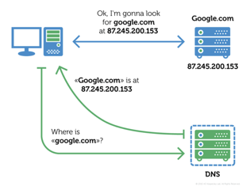
What will happen when we visit an URL?
URL vs IP Address
DNS - Domain Name System ： https://www.cloudflare.com/en-in/learning/dns/what-is-dns/

Slide 5
…now the browser received the API address …

Slide 6
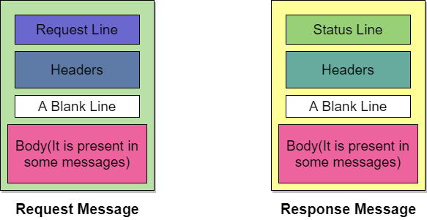
What is HTTP?
Hyper Text Transfer Protocol
HTTP Request Structure
HTTP Response Structure

Slide 7
HTTP Methods
Get —
Post —
Put —
Patch —
Delete —
Retrieve Data from server
Handle with data / Create new entry
Replace the whole data entry
Update part of the data entry
Delete the data entry
Restful API (constraints)- Representational State Transfer
CRUD - Create/ Read/ Update/ Delete

Slide 8
Different responses from server
HTTP Status Code
100 - 199 :
200 - 299:
300 - 399:
400 - 499:
500 - 599:
Information Responses 100 : Continue
Successful Responses 200: OK 201: Created
Redirection Messages 301: Moved Permanently
Client Error Responses 400: Bad Request 401:Unauthorized 404: Not Found
Server Error Responses 500: Internal Server Error 502: Bad Gateway
Notes:
https://apoorvtyagi.tech/finding-a-needle-in-haystack-fixing-mysterious-bad-gateway

Slide 9
…after browser get response from server, now…

Slide 10
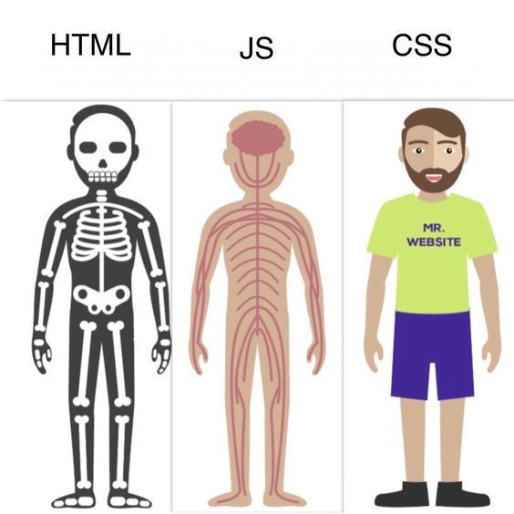
Relationships among HTML/CSS/JS

Slide 11
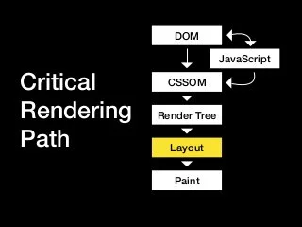
Browser starts rendering
HTML —> DOM (Document Object Model)
CSS —> CSSOM (CSS Object Model)
JS —> Compiled and manipulate HTML & CSS

Slide 12
Use Chrome Developer Tool
Elements — DOM Tree, Styling
Console — Console.log
Sources — Uglify/Minify Codes
Network — HTTP requests/ Network flow
Application — Storage
Lighthouse — Performance Test

Slide 13
Local Storage Vs. Session Storage vs. Cookies
 | Cookies | Local Storage | Session Storage
Capacity | 4 KB | 5 MB | 5 MB
Expiration | Manually Set | Never | On Tab Close
Accessible server-side | Yes | No | No

Slide 14
… Now it is time to write a HTML file …

Slide 15
How to create a html file?
HTML —> Hyper Text Markup Language
Extensions: .html
<!DOCTYPE> <html>
<head> <meta> <title>
<link> <script> <style>
<body>
Notes:
https://www.w3schools.com/tags/tag_meta.asp

Slide 16
HTML Elements
<h1> <div> <span>
<input> <button>
<ul> <li>
<br> <strong>
<video> <audio> <img>
<svg> <canvas> <iframe>
Self-Closed Tag

Slide 17
Semantic HTML
A semantic element clearly describes its meaning to both the browser and the developer.
<article> <aside> <details>
<header> <footer>
<section> <main> …
Notes:
https://www.w3schools.com/html/html5_semantic_elements.asp

Slide 18
SEO- Search Engine Optimization
https://developers.google.com/search/docs/beginner/seo-starter-guide#descriptionmeta

